Slide 1

AI-Powered Customer Review Analysing tool
Powered by Azure AI
Kuda

Slide 2
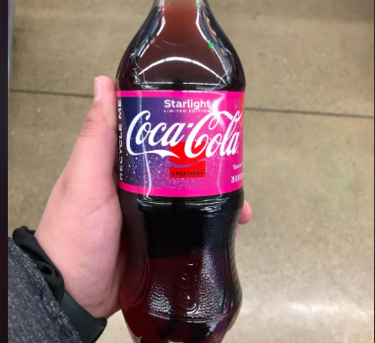



Slide 3

Project Overview
An automated pipeline that:
Fetch Reddit product reviews using PRAW.
Analyze sentiment and extract key phrases via Azure Text Analytics.
Generate personalized responses to each comment using Azure OpenAI.
Summarize recurring feedback themes and generate product-adjustment recommendations using key phrases.
Output both a detailed CSV for analysts and a management-ready Word report.

Slide 4
Leveraging Microsoft's AI stack for compliance-ready analytics
Service | Role | Value to the project
Azure text analytics | Sentiment analysis & key-phrase extraction from Reddit comments | Quickly surface customer pain points and positive aspects without manual review
Azure Open AI | Generate polite, personalized responses to comments. Summarize themes and recommend product adjustments based on key phrases | Enables natural, human-like language output and strategic insight generation
Python tooling (pandas,praw,docs) | Data engineering, report generation, code-based pipeline orchestration | Seamless automation from raw feedback to Word report delivery

Slide 5
Business Impact From raw comments to boardroom-ready insights in minutes
reduces manual feedback review time.
Automated analysis and responses support more personalized customer touchpoints, which can boost retention and satisfaction over time
Proactive reputation management
Summaries that link key phrases to themes and actionable suggestions give leadership clear direction for product improvement and prioritization

Slide 6

DEMO
AI-Powered Customer Review Analysis tool

